Slide 1

SOAP UI POC

Slide 2
Soap UI POC
Testing Objective
The objective of POC is to use SOAP UI tool to validate the Microservice Request and Response.
Test Scenarios*
Validate discount amount is sent in rules response as per valid request
Validate discount amount for Alabama state as per Drools Rule-set
Validate discount amount for Virginia state as per Drools Rule-set
Validate discount amount for New-York state as per Drools Rule-set
Validate error message sent in response for invalid request
Validate discount amount where input parameter for state is missing in Request
Validate discount amount for New-York state where State code sent in Request
Prerequisites
Business Rule-set
Approved request and response payload by the business and technical leads
Test Environment/Tools Required
Drools Microservice URL Link
Soap UI open source
* Test Scenarios were created based on dummy Drools Microservice and Rules set for Discount.
Notes:
Smoke test for access-

Slide 3
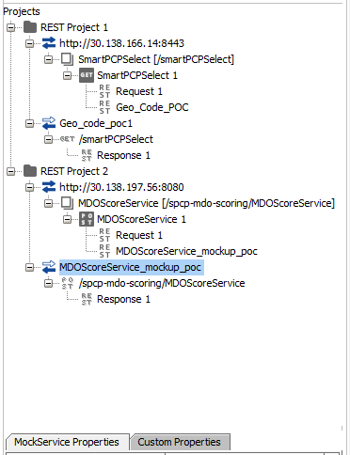
SOAP UI Service Mock-up for Bing
SOAP UI View
Bing Mock-up Flow
REST service
GET Geo code
Bing Mock up
geo_code
GET call for Geo Code
{
response
geo codes
}
REST service
MDO Score service
Bing Mock up
driving distance and duration
POST call for MDO score service
{
response
driving distance
driving duration
}

Slide 4
Soap UI Demo

Slide 5
Soap UI Pro Benefits :
Parameter | Soap UI Open Source | Soap UI Pro
Manual Test Step | √ | √
Message Assertion | √(Basic) | √
Data-Driven Test Automation | Х | √
Dynamic Data Generation | Х | √
Multi Environment Support | Х | √
Test Coverage | Х | √
Scripting Support (Groovy, JavaScript) | √ | √
Scripting Libraries | Х | √
e-Mailing Test Report with Groovy Script | Х | √
Test History: Baseline and Comparison | Х | √
Test Reporting(Printable & Export) | Х | √
Load UI | √ (Basic) | √
Secure UI | √ (Basic) | √

